Slide 1

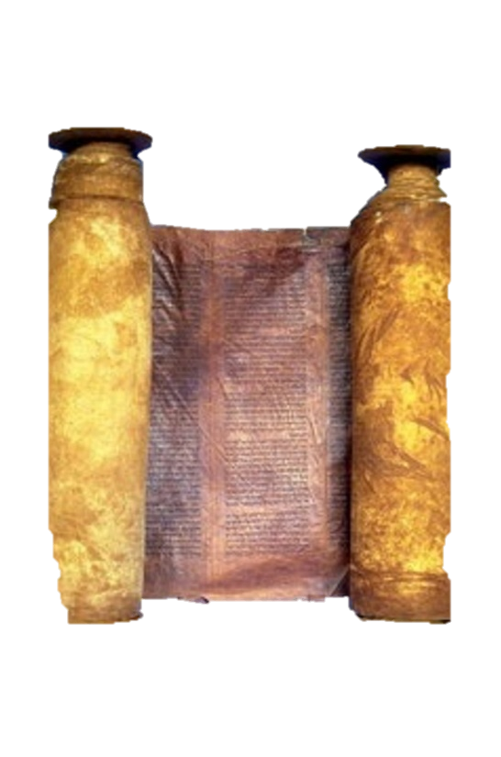




A free CD of this message will be available immediately following the service
2 Kings
23-25
A podcast will also be available later this week at calvaryokc.com

Slide 2



Perverted persons ~ KJV, sodomites - qadesh (from Hebrew word for holy)
2 kings 23-25

Slide 3
2 kings 23-25

Slide 4
Topheth ~ place of fire
2 kings 23-25

Slide 5
2 kings 23-25

Slide 6
Prov. 26:17 ~ He who passes by and meddles in a quarrel not his own
Is like one who takes a dog by the ears.
2 kings 23-25

Slide 7
2 kings 23-25

Slide 8
Israel
Judah
Josiah, 640-609
Jehoahaz, 609
2 kings 23-25

Slide 9
Jehoahaz ~ Yahweh has seized
2 kings 23-25

Slide 10
2 kings 23-25

Slide 11
Israel
Judah
Josiah, 640-609
Jehoahaz, 609
Jehoiakim, 608-598
2 kings 23-25

Slide 12
Jehoiakim ~ Yahweh will raise
2 kings 23-25

Slide 13
2 kings 23-25

Slide 14
1st deportation – 605 BC
(Daniel, et al)
620 BC
610 BC
600 BC
590 BC
580 BC
600 BC
Isaiah, Micah (posthumously),
Habakkuk and Jeremiah
2 kings 23-25

Slide 15
2 kings 23-25

Slide 16
Jehoiakim
Coniah (Jeremiah)
Jeconiah (2 Chronicles)
2 kings 23-25

Slide 17
2 kings 23-25

Slide 18
Nehushta ~ female form of Nehushtan (that brass thing, 2 Kings 18:4)
2 kings 23-25

Slide 19
2 kings 23-25

Slide 20
Israel
Judah
Josiah, 640-609
Jehoahaz, 609
Jehoiakim, 608-598
Jehoiachin, 597
2 kings 23-25

Slide 21
Jehoiachin ~ Yahweh will establish
2 kings 23-25

Slide 22
2 kings 23-25

Slide 23
1st deportation – 605 BC
(Daniel, et al)
2nd deportation – 597 BC
(Ezekiel, et al)
620 BC
610 BC
600 BC
590 BC
580 BC
600 BC
2 kings 23-25

Slide 24
2 kings 23-25

Slide 25
Israel
Judah
Josiah, 640-609
Jehoahaz, 609
Jehoiakim, 608-598
Jehoiachin, 597
Zedekiah, 597-586
2 kings 23-25

Slide 26
Mattaniah ~ gift of Yahweh
Zedekiah ~ Yahweh is righteous
2 kings 23-25

Slide 27
2 kings 23-25

Slide 28
1st deportation – 605 BC
(Daniel, et al)
2nd deportation – 597 BC
(Ezekiel, et al)
3rd deportation – 586 BC
(Temple razed)
610 BC
605 BC
600 BC
595 BC
590 BC
585 BC
2 kings 23-25

Slide 29
2 kings 23-25

Slide 30
Ezekiel 12:13 ~ I will also spread My net over him, and he shall be caught in My snare. I will bring him to Babylon, to the land of the Chaldeans; yet he shall not see it, though he shall die there.
2 kings 23-25

Slide 31
2 kings 23-25

Slide 32
Captain of the guard ~ better, chief executioner
2 kings 23-25

Slide 33
2 kings 23-25

Slide 34
Gedaliah ~ Yahweh has become great
2 kings 23-25

Slide 35
2 kings 23-25

